Slide 1
Programming Assignment #4
Operating System
201732831 Oh hyeonho 오현호
dhgusgh123@naver.com

Slide 2
Architecture
Reusing functions and making them perform as they go.
Part of the functions required in this project is delegated to each struct, and the functions are implemented through a function that receives each struct as an argument, and then combined with each other.

Slide 3
Process
typedef struct Process {
uint8_t pid;
uint8_t priority;
uint64_t arrivalTime;
uint64_t burstTime;
uint64_t initialRunningTime;
uint64_t notRunningSince;
uint64_t remainingBurstTime;
} Process;
typedef struct ProcessNode {
Process *process;
struct ProcessNode *prev;
struct ProcessNode *next;
} ProcessNode;
typedef struct ProcessQueue {
ProcessNode *head;
ProcessNode *tail;
size_t size;
} ProcessQueue;
Implement a struct similar to the PCB that shows the execution state of the process, and create a Doubly linked list containing it and call it ProcessQueue.
The field indicating the current state of the process is not separately implemented, but the state of an arbitrary process can be determined by synthesizing the values of each field.

Slide 4
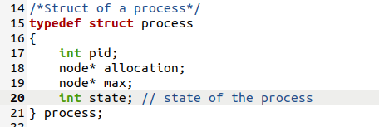
Process
typedef struct Context {
ProcessQueue jobQueue;
ProcessQueue readyQueue;
Process *currentProcess;
uint64_t elapsedTime;
uint64_t currentProcessStartTime;
} Context;
A process is implemented as a structure with pid, allocation list, and max list.

Slide 5
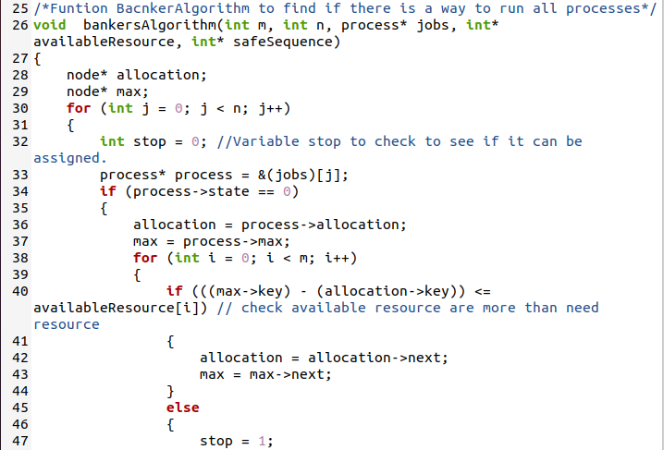
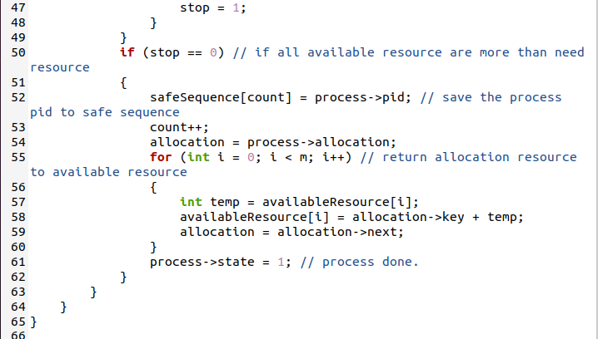
Bankers Algoritm
typedef struct Scheduler {
Process *(*whatToStart)(const Context *ctx, void *data);
int (*whetherToStop)(const Context *ctx, void *data);
void *data;
} Scheduler;
By comparing the max - alloction value for each resource and the quantity of available resources through the Bankers algorithm, if allocation is possible, the allocation resource is allocated to the available resource, otherwise it is passed.

Slide 6
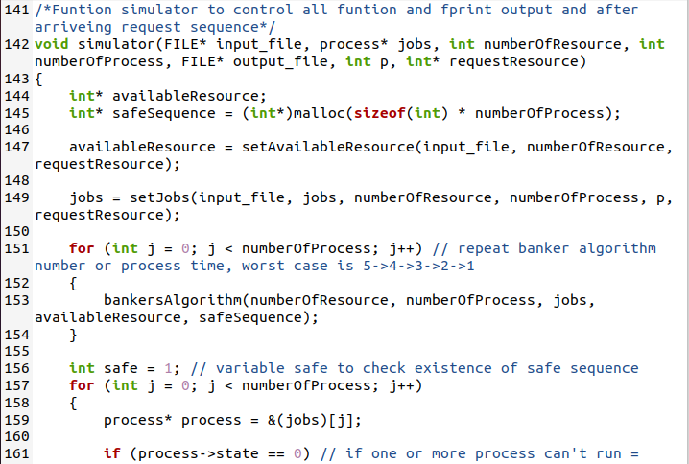
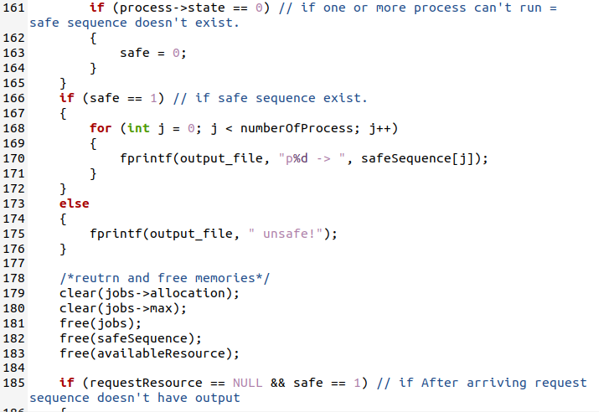
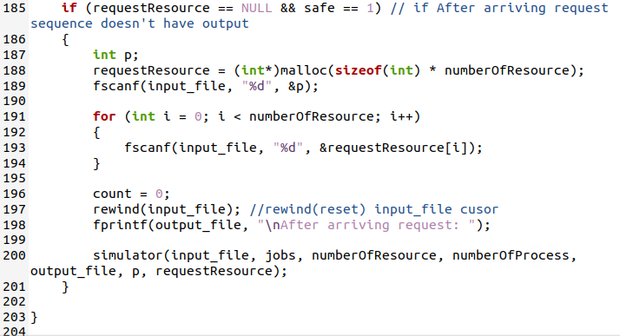
Simulator
typedef struct Scheduler {
Process *(*whatToStart)(const Context *ctx, void *data);
int (*whetherToStop)(const Context *ctx, void *data);
void *data;
} Scheduler;
It calls each function to do FILE I/O, compares it through the bankers algorithm, and saves the result to the output file. If it asks if new resource allocation is possible, the answer is stored through recursion.

Slide 7
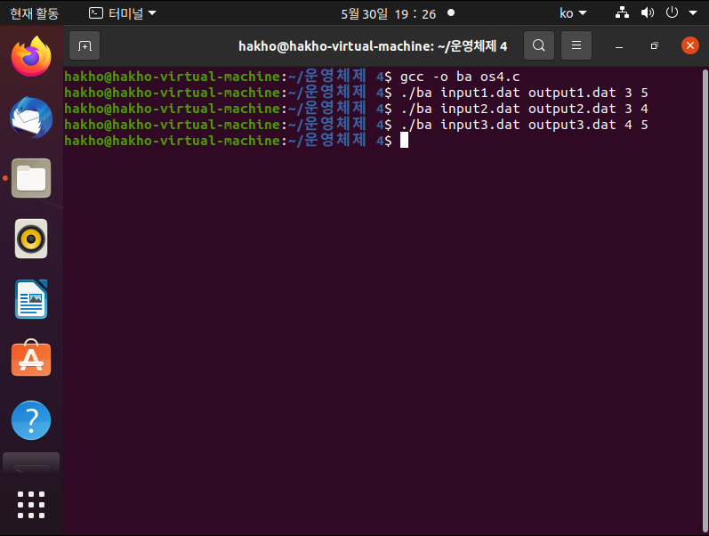
Compile & Run
Input file with 3 resources and 5 processes.
Input file with 3 resources and 4 processes.
Input file with 4 resources and 5 processes.

Slide 8
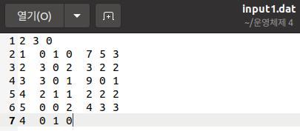
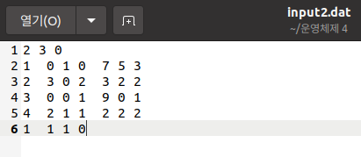
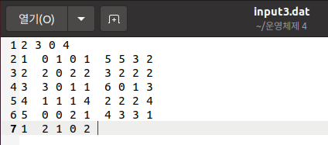
Result
Three input files
Input1.dat
Input2.dat
Input3.dat

Slide 9
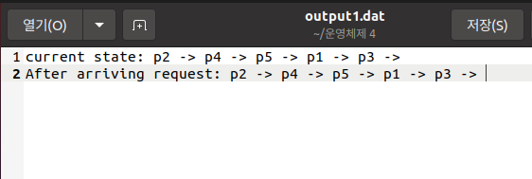
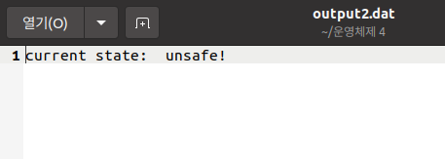
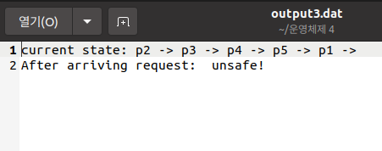
Result
Different results with different inputs
1.Allocation possible even if the current state and new allocation request are accepted.
2. Cannot be assigned even in the current state.
3. The current state can be assigned, but new assignment requests cannot be accepted.

